Slide 1

AIRLINE ON-TIME PERFORNAMCE VISUALIZATION USING TABLEAU
By: Baraki, Welemhret Welay
Instructor: Mikael Berndtsson

Slide 2
Presentation outline
Introduction
BI Analysis and Visualization of years 1989 and 1999
Data Collection and Preparation
Q1: What characterize flights that are on-time?
Q2: Which regions, airline carriers and airports have highest diverted flights?
Ethical dilemmas according to (Solove ,2006)

Slide 3
Introduction
BI Technologies (Chaudhuri, Dayal & Narasayya, 2011) are widely deployed and used in businesses and industries
The airline sector (Fatima, 2022) uses different BI technologies:
Analyze and monitor climate change
Control and analyze flights
Forecasting weather conditions to detect risks
Current Project:
Data Preprocessing and data preparation using Python (i.e. Pandas)
Visualization: Tableau BI Tool
Maps, bar charts and line graphs
Required parameters and features are analyzed, interpreted and reported with the visuals generated based on the formulated Questions.

Slide 4
Data Collection and Preparation
Datasets collected form (Harvard Dataverse ,2008) of 1989 & 1999.
The dataset of the two years has 10 million records and 29 features.
Instead of using IATA Codes
Problem: Difficult to understand by the users
Solution: Uses Airport names, region/state/ names, and unique carrier/airline names/

Slide 5
Q1: What characterize flights that are on-time?
To answer this question the following considered:
-Flight Status /Delays
-Regions
-Airports
-Airlines
-Years
-Quarters
-Months
-Weekdays

Slide 6
Q1: What characterize flights that are on-time?
On time Flight status From Regions:
California and Texas have high On-time and delayed flights on both years
Cancellation of Flights:
1989: New York , Texas, Florida, California, Georgia and Illinois
1999: Illinois, California and Texas
The cancellation of flights increased in 1999 in the states of Illinois, California and Texas.

Slide 7
Q1: What characterize flights that are on-time?
On time Flight status From Airlines:
Delta Airlines and American are the top Airlines that arrive/depart/ on-time in the two years of 1989 and 1999.
On-time: Delta Airlines(1989), and Southwest Airlines (1999)
Cancellations: Eastern Airlines(1989), US Airways (1999)
Reasonably Delta airlines delays an average of 7 minutes

Slide 8
Q1: What characterize flights that are on-time?
On time Flight status From Airports:
Punctuality pays off, so that the airports that have high on-time flights are more preferable by the customers.
On-time Flight status: Hartsfield–Jackson Atlanta International Airport(1989) and Chicago O'Hare International Airport(1999)
The airports of Gustavus and Petersburg James Airports have high departure and arrival delays an average of 18 to 19 minutes. These airports are found in Alaska. These delays can be due to the environmental conditions of that particular arctic region.

Slide 9
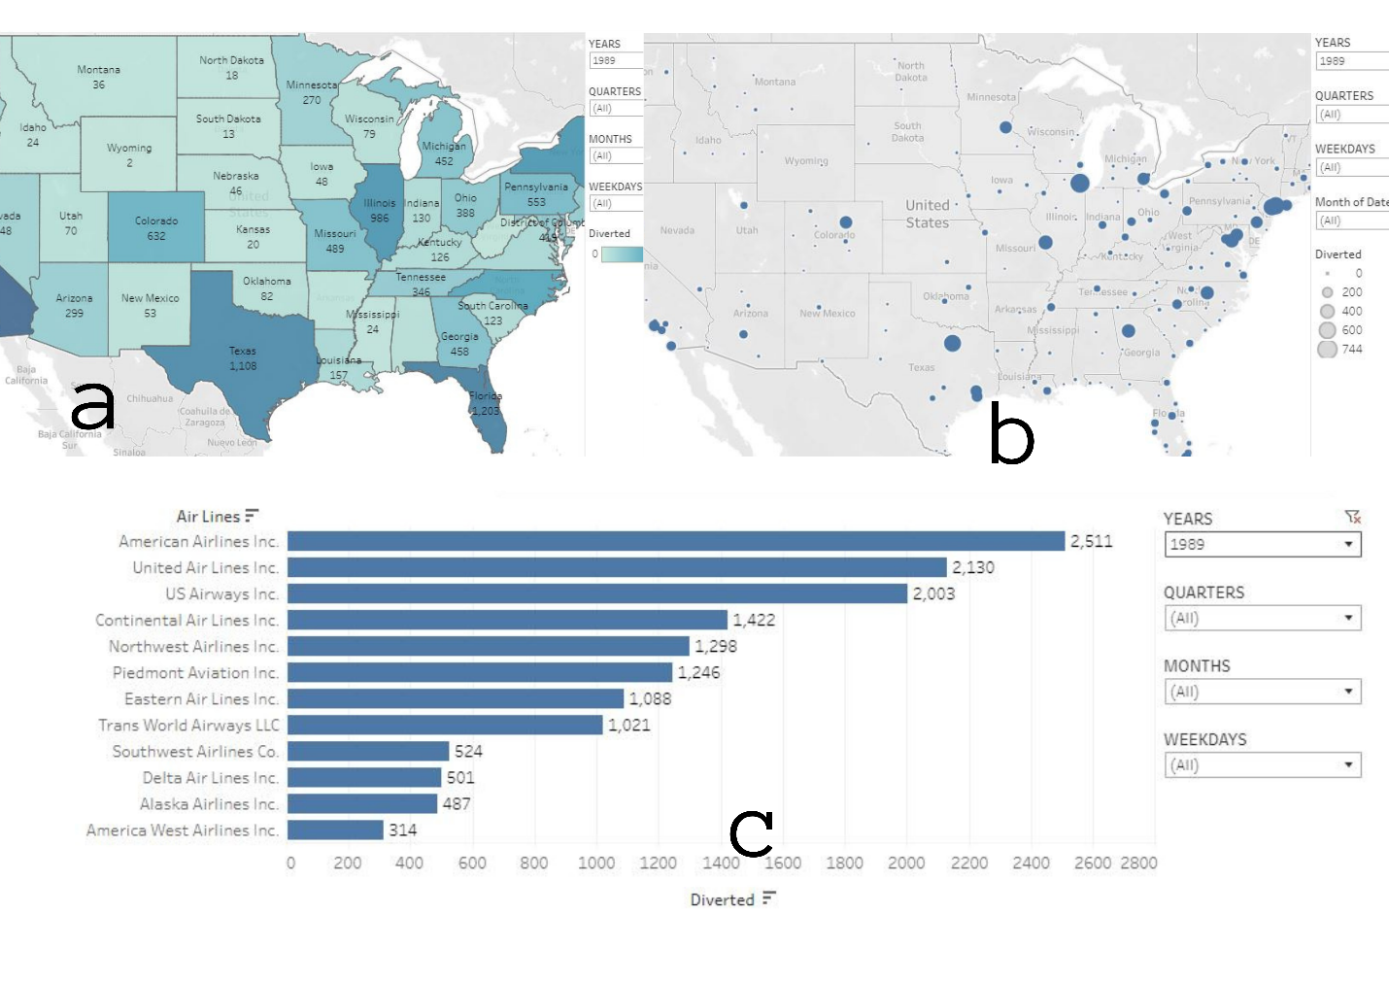
Q2: Which regions, airline carriers and airports have highest diverted flights?
Diverted flights can be caused due to many reasons.

Slide 10
Ethical dilemmas according to (Solove ,2006)
A bigger airport intends to collect data from the travellers’ smart phones, flight plans, passport control, security control, and visits to shops and restaurants. The intention is to collect data, and then categorise travellers. In the future, travellers that are categorised as “likely to cause late departure of flight” will receive reminders via text message and staff around the airport can access a dashboard that can indicate in which areas the traveller might be in. Future plans also include to install a facial recognition system in shops and restaurants.

Slide 11
Ethical dilemmas according to (Solove ,2006)
Information Collection
Information Processing
Information Dissemination
Invasion

